Slide 1


Optimization Algorithms
Course Presentation
Alaa Khamis, Ph.D
AI and Smart Mobility Professor at KFUPM and Ex- GM Technical Leader
This lecture is based on Part-I Deterministic Search Algorithms of the textbook: Optimization Algorithms: AI techniques for design, planning, and control problems, Manning Publication, 2024.
2025 © Dr. Alaa Khamis

Slide 2
Outline
Course Description
Teaching Methodology
Learning Outcome
Course Topics
Course Outline
Resources
GenAI Dos and Don’ts
Notes:
2

Slide 3
Outline
Course Description
Teaching Methodology
Learning Outcome
Course Topics
Course Outline
Resources
GenAI Dos and Don’ts
Notes:
3

Slide 4
Course Description
This course provides a comprehensive introduction to the field of optimization using modern AI techniques. Students will learn to apply various optimization algorithms to solve real-world design, planning, and control problems. The course will explore both deterministic and stochastic methods, including graph search, trajectory-based, evolutionary, and swarm intelligence algorithms, as well as machine learning approaches to optimization. Adaptive aspects of these algorithms will be discussed.
Exploration-exploitation dilemma
An ill-structured problem
Design problem
Planning problem
Control problem
Optimization Algorithm
Optimal or near-optimal solution
Adaptation
Deterministic approach
Adaptive approach
Self-adaptive approach
Notes:
4

Slide 5







Course Description
Optimization is everywhere
Have you ever wondered how navigation apps like Google Maps and Apple Maps determine the fastest route from one place to another?
Have you been curious about how ride-sharing companies like Uber, Lyft, or DiDi guide their drivers to the best spots to reduce your wait time and their travel distance, making things better for everyone?
Or perhaps you’ve asked yourself how food delivery platforms like Uber Eats suggest food choices for you.
Have you considered how last-mile delivery apps map out the fastest routes for parcel deliveries while minimizing empty return trips?
Do you ever wonder how emergency responders are dispatched swiftly to incidents? Have you thought about the process behind selecting locations for electric vehicle charging stations? Or how to calculate the optimal price for a product, optimize investment portfolios, allocate resources, or schedule surgeries efficiently?
Notes:
5

Slide 6
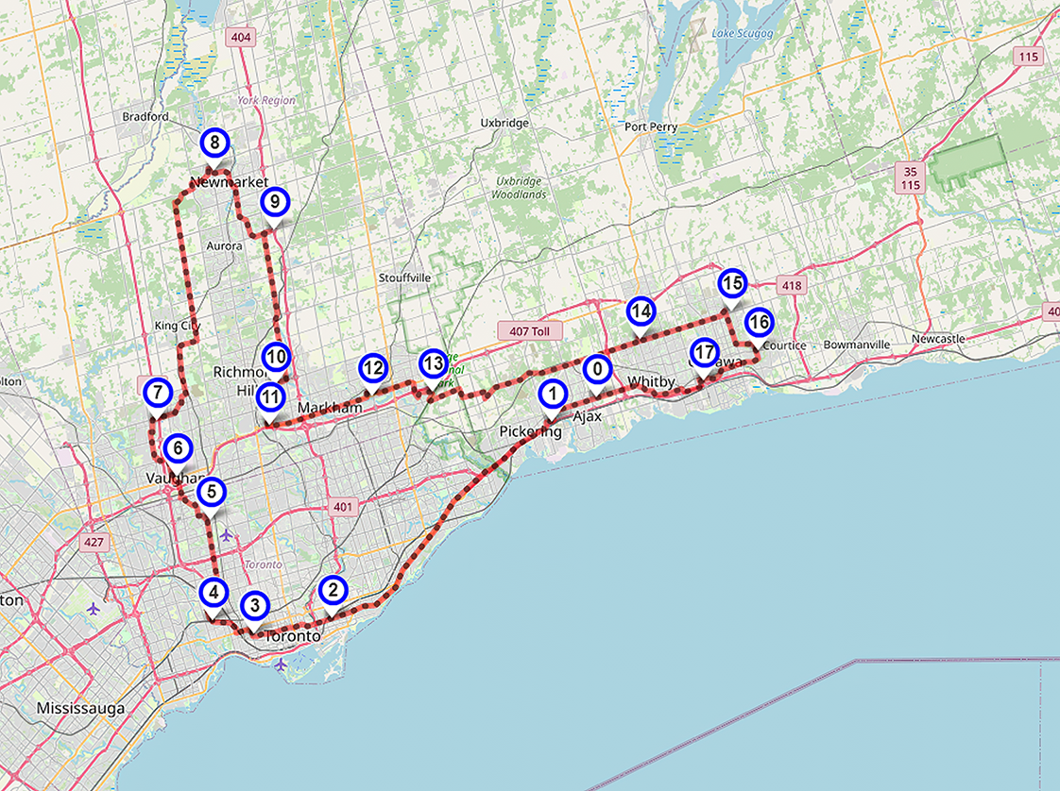
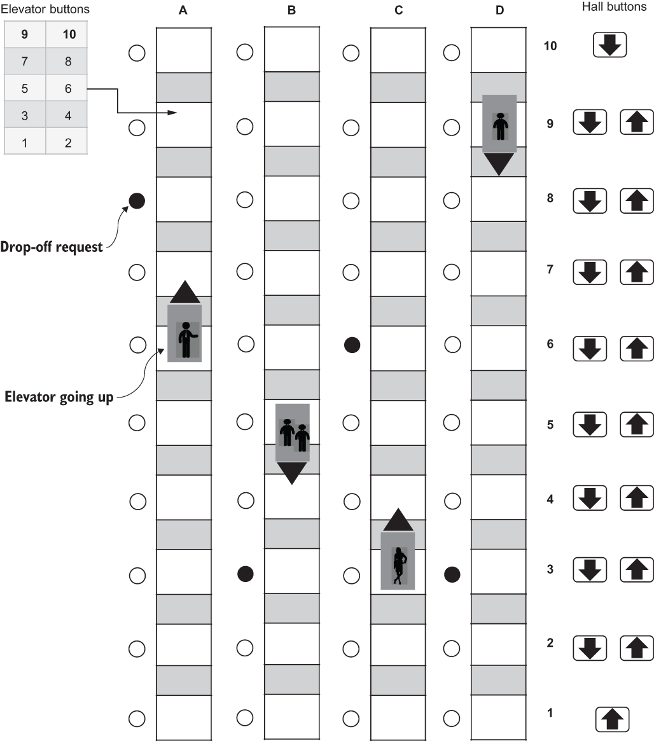

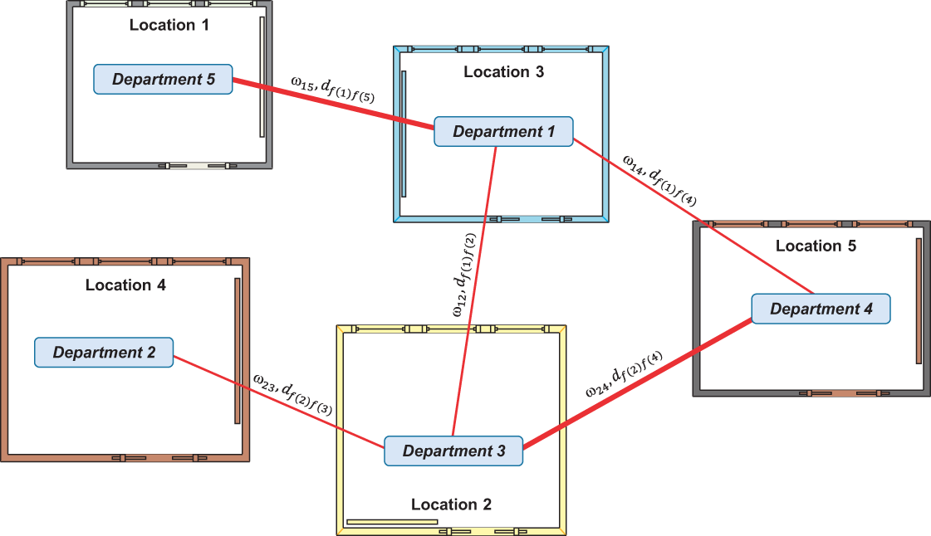

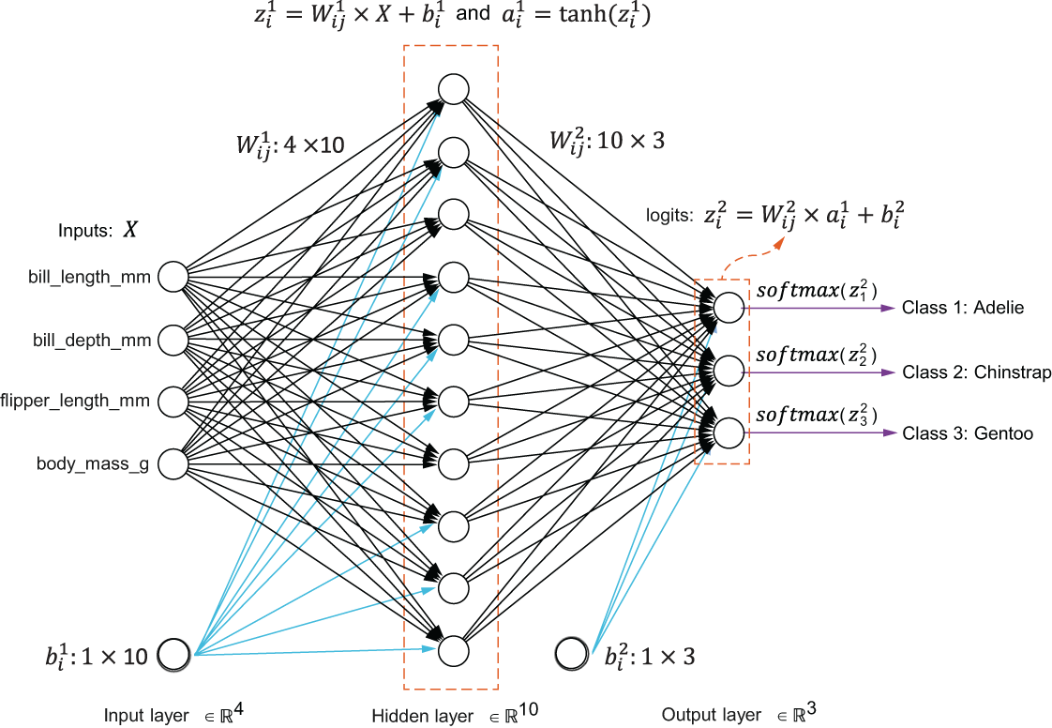
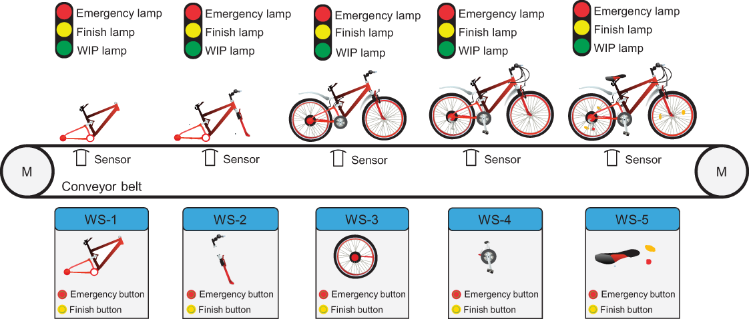
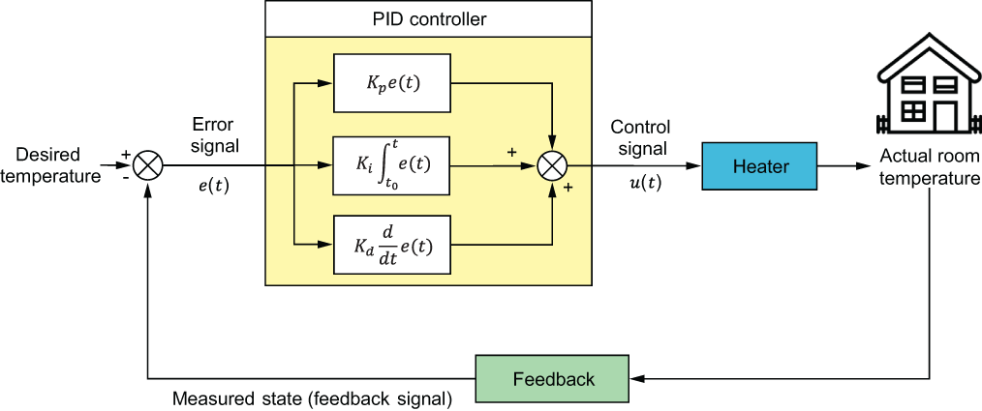
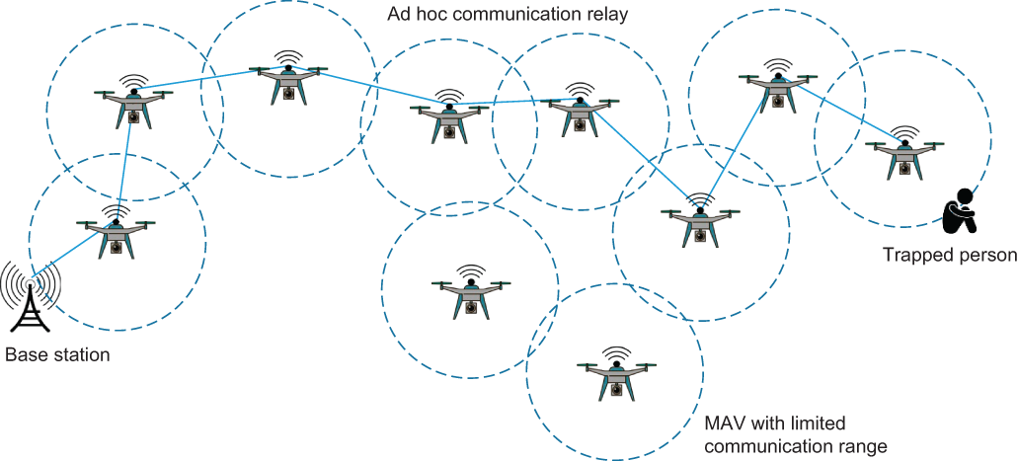
Course Description
Optimization is everywhere
Routing
Elevator dispatching
Railway/Airline scheduling
Plant layout
NN Training
PID Auto-Tuning
Communication relaying
Assembly line balancing
And many more. . .
Notes:
6

Slide 7
Course Description
Well-structured Problems (WSP)
A priori knowledge
Initial states
Problem Space
Problem Solver
Updated state
Monitoring
Goal state
Solution execution upon external world
Feasible states
Proposed solution
Evaluation Criterion
Optimal/near-optimal solution
Operators
Legal moves/ transitions
Stopping criteria
Hard/Soft Constraints
Generate alternative solution
Computational tractability
Notes:
7

Slide 8


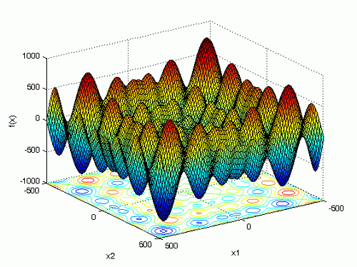
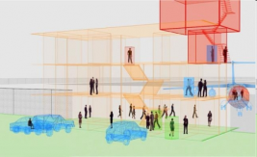
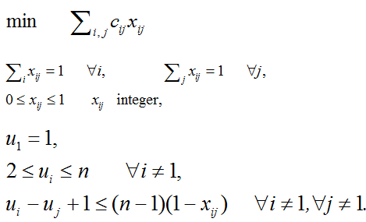
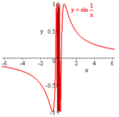





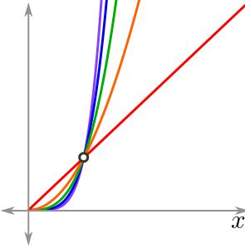
Course Description
Ill-structured Problems (ISP)
Problem Space
Problem Solver
Different views of problem
Unclear Goal
Multimodality
Dynamic nature
Lack of exact mathematical model
Non-Differentiability
No algorithmic solutions
Evaluation Criterion
Monitoring
Considerable uncertainty, partial observability, vagueness, incomplete information, ambiguity and unpredictability
Solutions are contradictory
Consequence difficult to predict
Risk difficult or impossible to calculate
Computation
Computational intractability
Notes:
8

Slide 9
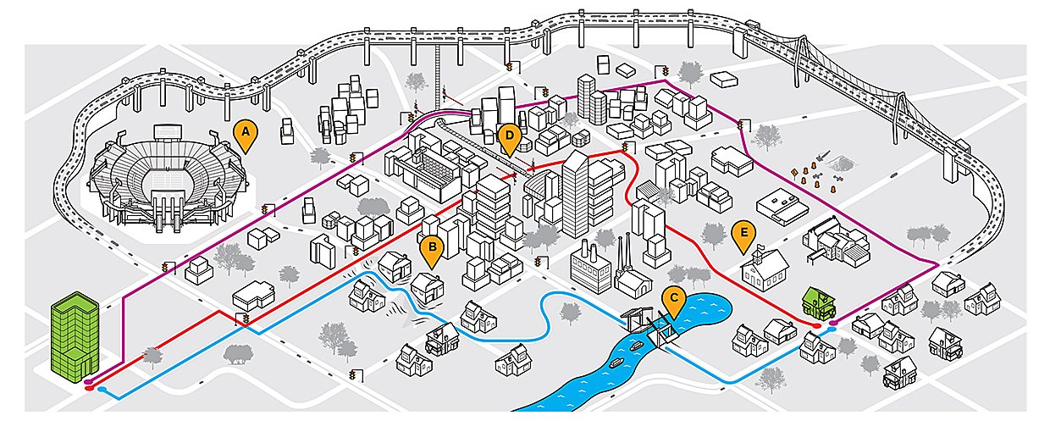
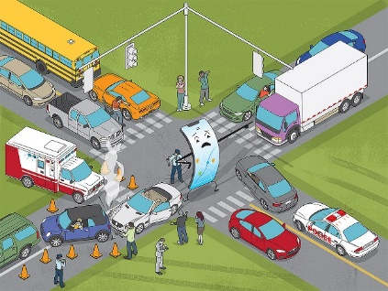
Course Description
ISP: Routing and Navigation
[Source]
Dynamic nature . Different views of problem . Partial observability . Incomplete information . Multimodality
Notes:
9

Slide 10
Course Description
ISP: Elevator dispatching
Dynamic nature . Partial observability . Computation
10⁴
.
2⁴⁰
.
18⁴
≈
10²¹
Elevator positions
Each elevator can be on one of 10 floors. Therefore, for each elevator, there are 10 different possible states. Since there are four elevators, the number of combinations for elevator positions is 10⁴.
Elevator buttons
Each elevator has 10 buttons that can be either on (pressed)
or off (not pressed). Therefore, for one elevator, there are 210 different possible
states. Since there are four elevators, the number of combinations for elevator
buttons is 2⁴⁰.
Hall call buttons
There are 18 hall call buttons (up and down buttons at each
floor, except the first and the last floor) that can be either on or off. Therefore,
the number of combinations for hall call buttons is 2¹⁸.
States
Notes:
10

Slide 11
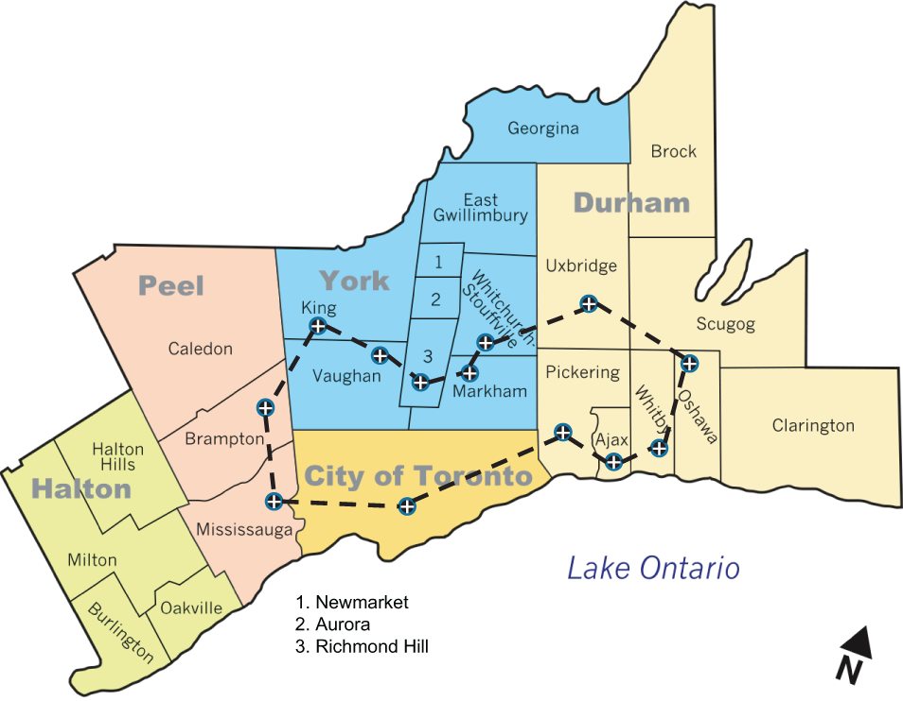
Course Description
WSP but practically ISP: TSP
Given n cities,
A travelling salesman must visit the n cities and return home, making a loop (roundtrip).
He would like to travel in the most efficient way (cheapest way or shortest distance or some other criterion).
Search Space
Search space is BIG:
for 13 cities there are (13-1)! ≈ 479,001,600 possible tours *. This is NP-hard problem.
*Fortunately, dynamic programming algorithms enable reduced complexity as explained in Chapter 2 of the textbook.
Notes:
11

Slide 12
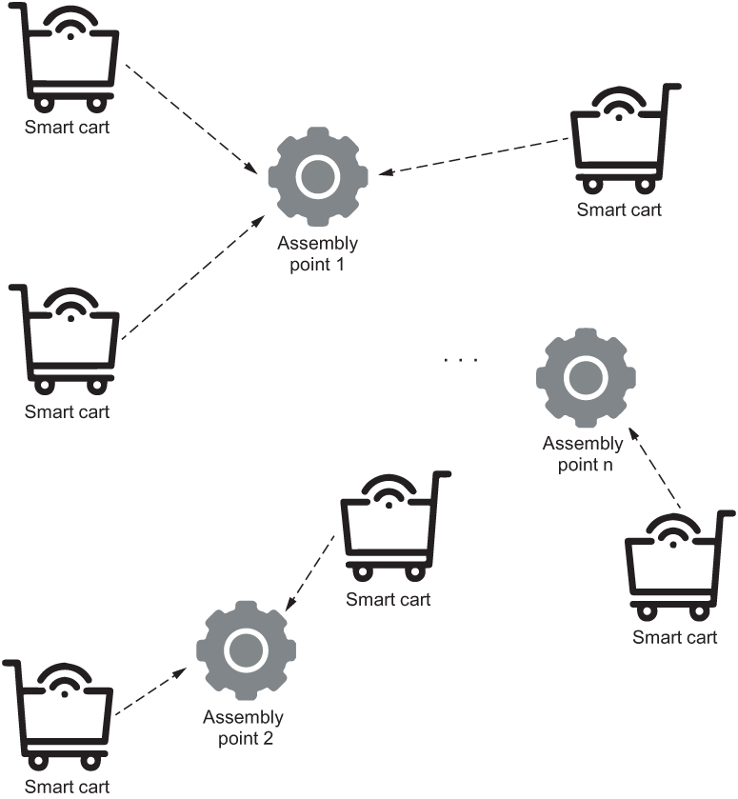
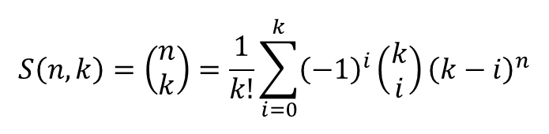
Course Description
WSP but practically ISP: Clustering
Stirling number of the second kind (or Stirling partition number)
$$S\left(n,k\right)=\left(\begin{matrix}n \\ k\end{matrix}\right)=\frac{1}{k!}\sum_{i=0}^{k}{{\left(−1\right)}^{i}\left(\begin{matrix}k \\ i\end{matrix}\right){\left(k−i\right)}^{n}}$$
Example: If n=50 and c=4, the number is 5.3x10²⁸
If n is increase to 100, the number becomes 6.7x10⁵⁸.
So, enumerating all possible partitions for large problems is practically not feasible
Notes:
12

Slide 13
Course Description
Optimization Problems
Quality of Solutions
Search Time
+
+
High
Design Problems (Strategic Functions)
(e.g., vehicle design, class scheduling, asset allocation, resource planning, assembly line balancing, inventory management, mobility-as-a-service bundling, flight scheduling and political districting)
Long & Infrequent (min.-days)
Planning Problems (Tactical Functions)
(e.g., motion planning, emergency vehicle dispatching and routing, patient admission scheduling, surgery scheduling and crew scheduling)
Medium
Medium & Intermittent (s-min.)
Control Problems (Operational Functions)
(e.g., vehicle lateral/longitudinal motion control, ad hoc communication relaying, adaptive traffic control and network traffic management)
Low
-
-
Short & Continuous (ms-s)
Notes:
13

Slide 14
Course Description
Optimization Problems
Optimization Problems
Benchmark/Classic Problems
Real-world Problems
Examples:
Mathematical test functions (e.g., Ackley, Easom, EggCrate, Eggholder, Rastrigin, Schaffer, McCormick, Beale, Branin, Colville and Rosenbrock)
n-Puzzle Problem
n-queens Problem
Grid Search Problem
Bin Packing Problem
Knapsack Problem
Minimum Spanning Tree (MST)
Travelling Salesman Problem (TSP)
Chinese Postman Problem (CPP)
Optimal Assignment Problem (OAP)
Quadratic Assignment Problem (QAP)
Job Shop Scheduling Problem (JSP)
Graph Coloring Problem
Design Problems
Planning Problems
Control Problems
Examples:
Suspension/wheel Design
VLSI Design
Assembly Line Balancing (ALBP)
Railway Scheduling
PID Controller Design
Timetabling Problem (TTP)
Political Districting Problem
Hospital Resource Planning
Optimal placement of physical assets (e.g., cameras, EV charging stations)
Examples:
Motion Planning
Ride-sharing/Ride-hailing
Shifts Planning
Task Allocation
Vehicle Routing Problem (VRP)
Appointment Scheduling
Patient Admission Scheduling
Fitness Planning
Trip Itinerary Planning
Eco-efficient Delivery
Deadheading Problem
Examples:
Elevator Dispatching
Communication Relaying
Lateral and Longitudinal Motion Control
Multirobot Control
Targeted Drug Delivery using Microrobots
Multiple Target Clustering
Dynamic Order Orchestration
Self-driving Vehicle (SDV) Coordination in Warehouses
Truck Platooning
Notes:
14

Slide 15
Course Description
Optimization Algorithms
Deterministic Algorithms
Stochastic Algorithms
Numerical/Classical Methods
Graph Search Methods
Trajectory-based
(S-Metaheuristics)
Population-based
(P-Metaheuristics)
Machine Learning-based Methods
Blind Search
Informed Search
Evolutionary Computing (EC)
Swarm Intelligence
(SI)
Unsupervised Learning
Supervised Learning
Reinforcement Learning
Markov Decision Process (MDP)
Multi-armed Bandit (MAB)
Notes:
15

Slide 16
Outline
Course Description
Teaching Methodology
Learning Outcome
Course Topics
Course Outline
Resources
GenAI Dos and Don’ts
Notes:
16

Slide 17
Teaching Methodology
Search algorithm/optimization solver
Find optimal/near-optimal values of a decision vector which minimize/maximize a set of objective functions subject to a set of hard and/or soft constraints
Algorithm source of inspiration
Algorithm pseudocode
Algorithm parameters and heuristics
Apply to …
A search/optimization problem
Algorithm pros and cons
Benchmark/classic problems
Real-world problems
Algorithm adaptation
Hand-iterations on a scaled-down problem
Python programming on a scaled-up problem
Algorithm refinement and tuning
Notes:
17

Slide 18
Outline
Course Description
Teaching Methodology
Learning Outcome
Course Topics
Course Outline
Resources
GenAI Dos and Don’ts
Notes:
18

Slide 19

Learning Outcomes
Understand core concepts of search and optimization.
Apply deterministic and stochastic optimization techniques to practical problems.
Implement and adapt graph search algorithms, trajectory-based algorithms, and evolutionary computing algorithms.
Leverage swarm intelligence and machine learning methods for optimization.
Use state-of-the-art Python libraries for optimization tasks.
Evaluate and compare different optimization strategies to determine the most effective approach for given scenarios.
Notes:
19

Slide 20
Outline
Course Description
Teaching Methodology
Learning Outcome
Course Topics
Course Outline
Resources
GenAI Dos and Don’ts
Notes:
20

Slide 21
Course Topics
Search and optimization
Heuristics and metaheuristics
Graph search methods
Stochastic search
Genetic algorithms
Swarm intelligence algorithms
Machine learning methods
Notes:
21

Slide 22
Outline
Course Description
Teaching Methodology
Learning Outcome
Course Topics
Course Outline
Resources
GenAI Dos and Don’ts
Notes:
22

Slide 23
Course Outline
Week 1-2: Introduction to Search and Optimization
Topics:
Course Presentation
Introduction to Search and Optimization
Readings:
Chapter 1: Introduction to search and optimization
Chapter 2: A deeper look at search and optimization
Notes:
23

Slide 24
Course Outline
Week 3-4: Graph Search Algorithms
Topics:
Blind search algorithms.
Informed search algorithms.
Readings:
Chapter 3: Blind search algorithms
Chapter 4: Informed search algorithms
Notes:
24

Slide 25
Course Outline
Week 5-6: Trajectory-Based Optimization
Topics:
Simulated annealing.
Tabu search.
Readings:
Chapter 5: Simulated annealing
Chapter 6: Tabu search
Notes:
25

Slide 26
Course Outline
Week 7-8: Evolutionary Computing Algorithms
Topics:
Genetic algorithms.
Genetic algorithm variants.
Readings:
Chapter 7: Genetic algorithms
Chapter 8: Genetic algorithm variants
Notes:
26

Slide 27
Course Outline
Week 9-10: Swarm Intelligence Algorithms
Topics:
Particle swarm optimization.
Other swarm intelligence algorithms.
Readings:
Chapter 9: Particle swarm optimization
Chapter 10: Other swarm intelligence algorithms to explore
Notes:
27

Slide 28
Course Outline
Week 11-12: Machine Learning for Optimization
Topics:
Supervised and unsupervised learning.
Reinforcement learning.
Readings:
Chapter 11: Supervised and unsupervised learning
Chapter 12: Reinforcement learning
Notes:
28

Slide 29
Outline
Course Description
Teaching Methodology
Learning Outcome
Course Topics
Course Outline
Resources
GenAI Dos and Don’ts
Notes:
29

Slide 30

Resources
Textbook
Alaa Khamis. Optimization Algorithms: AI Techniques for Design, Planning, and Control Problems. Manning Publication, ISBN 9781633438835, 2024.
Notes:
30

Slide 31

Resources
Open-source sample codes and data
Sample Code: https://github.com/Optimization-Algorithms-Book/Code-Listings
Exercises and Solutions: Appendix C of the textbook
Sample Projects: AI for Smart Mobility Medium Publication Hub
Join us
Notes:
31

Slide 32
Outline
Course Description
Teaching Methodology
Learning Outcome
Course Topics
Course Outline
Resources
GenAI Dos and Don’ts
Notes:
32

Slide 33

GenAI Dos and Don’ts
Do use GenAI tools responsibly and ethically to enhance learning and research
Do use GenAI for brainstorming and proofreading
Do cite any AI assistance
Don’t blindly trust GenAI without fact-checking
Don’t use GenAI as the only source of information
Don’t use GenAI to complete entire assignments
Don’t overuse GenAI to avoid cognitive offloading
Notes:
33

Slide 34
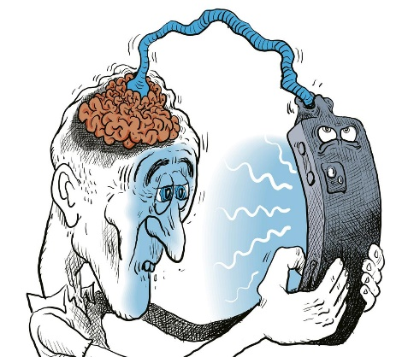
GenAI Dos and Don’ts
Over-reliance on AI
Cognitive offloading
Memory retention (‘Google effect’)
Fragmentation of attention
Reduced problem-solving ability
Loss of critical thinking
Engineer – Critical Thinking = Unengineer
Notes:
34

Slide 35
Questions?
Notes:
35

